Slide 1
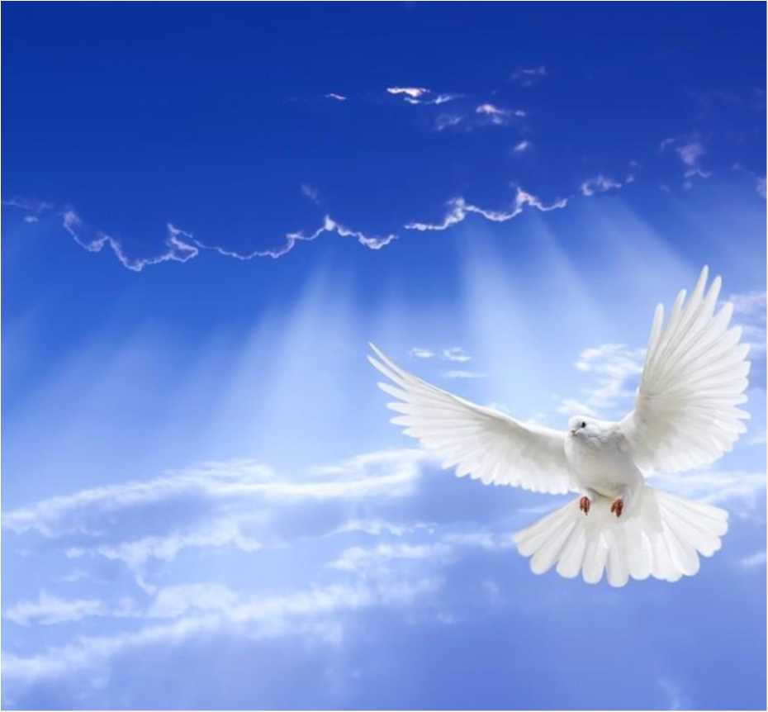




B #1:2022^6^ 26 B
mfcmmmmwmm

Slide 2
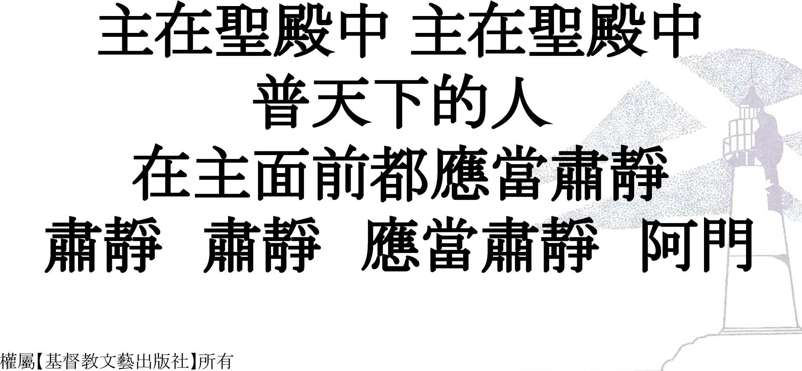

Slide 3
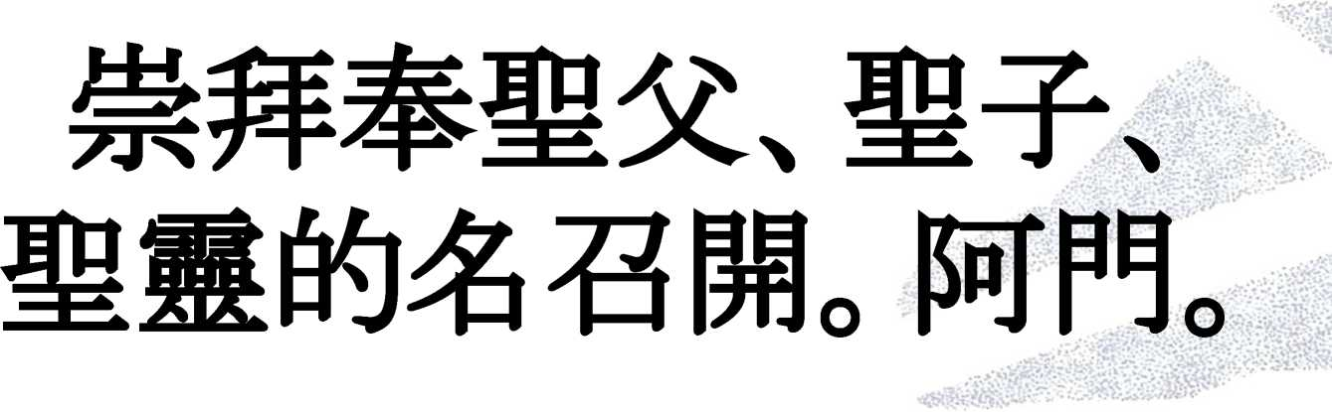
Call to worshi

Slide 4
Reconciliation

Slide 5
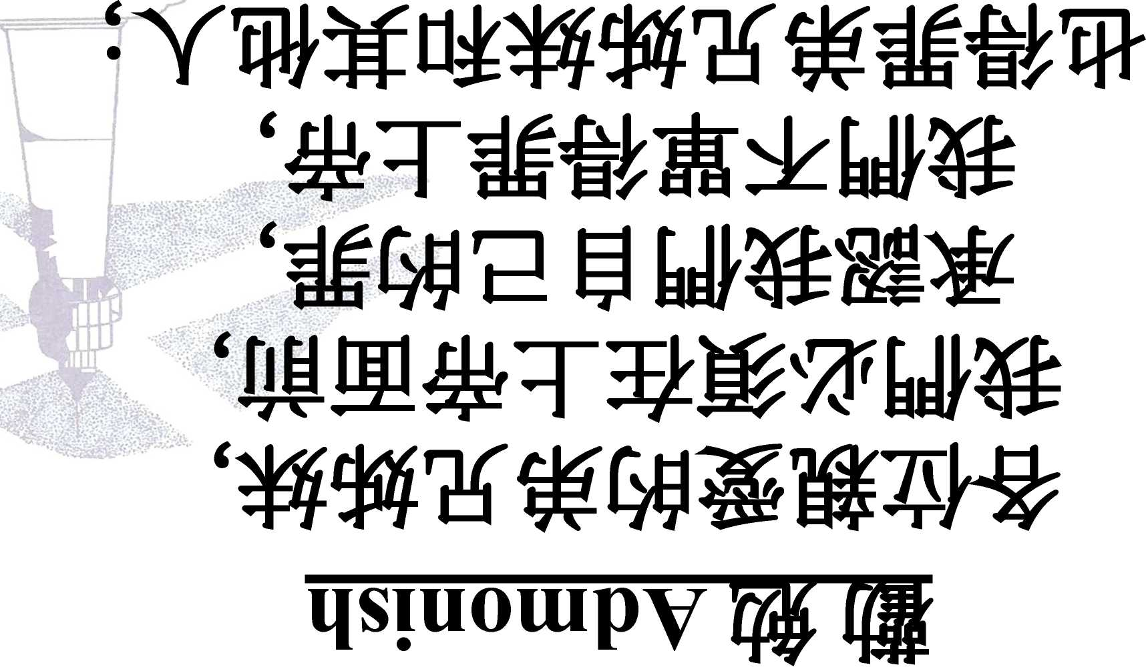

Slide 6
SIUOUI

Slide 7
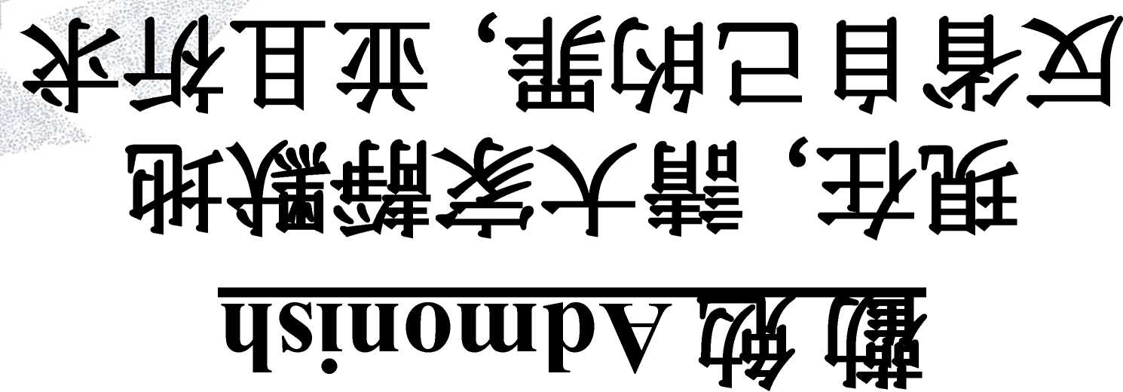

Slide 8
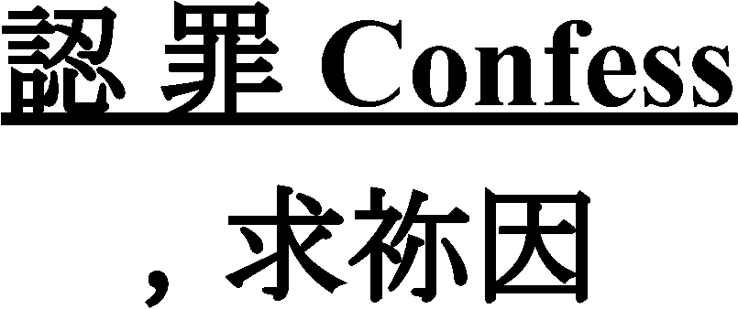

Slide 9
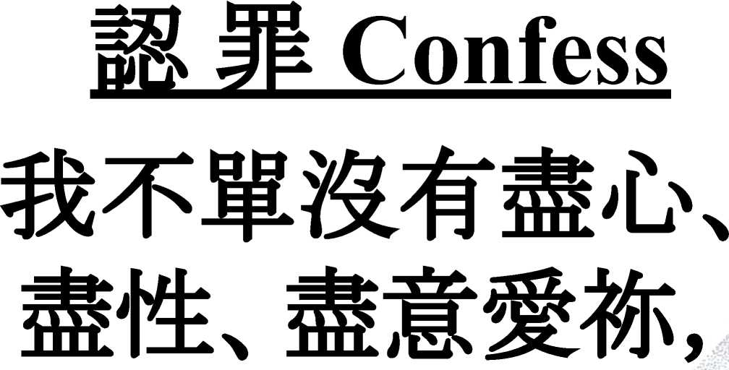

Slide 10
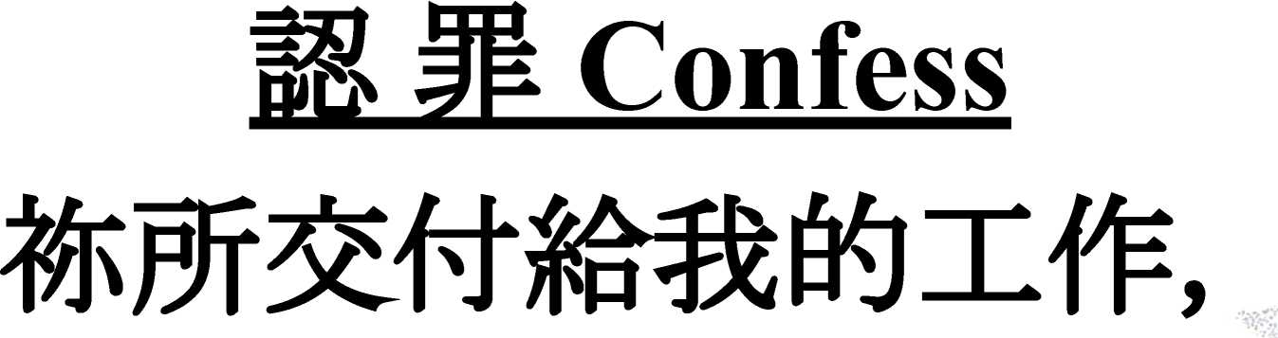

Slide 11
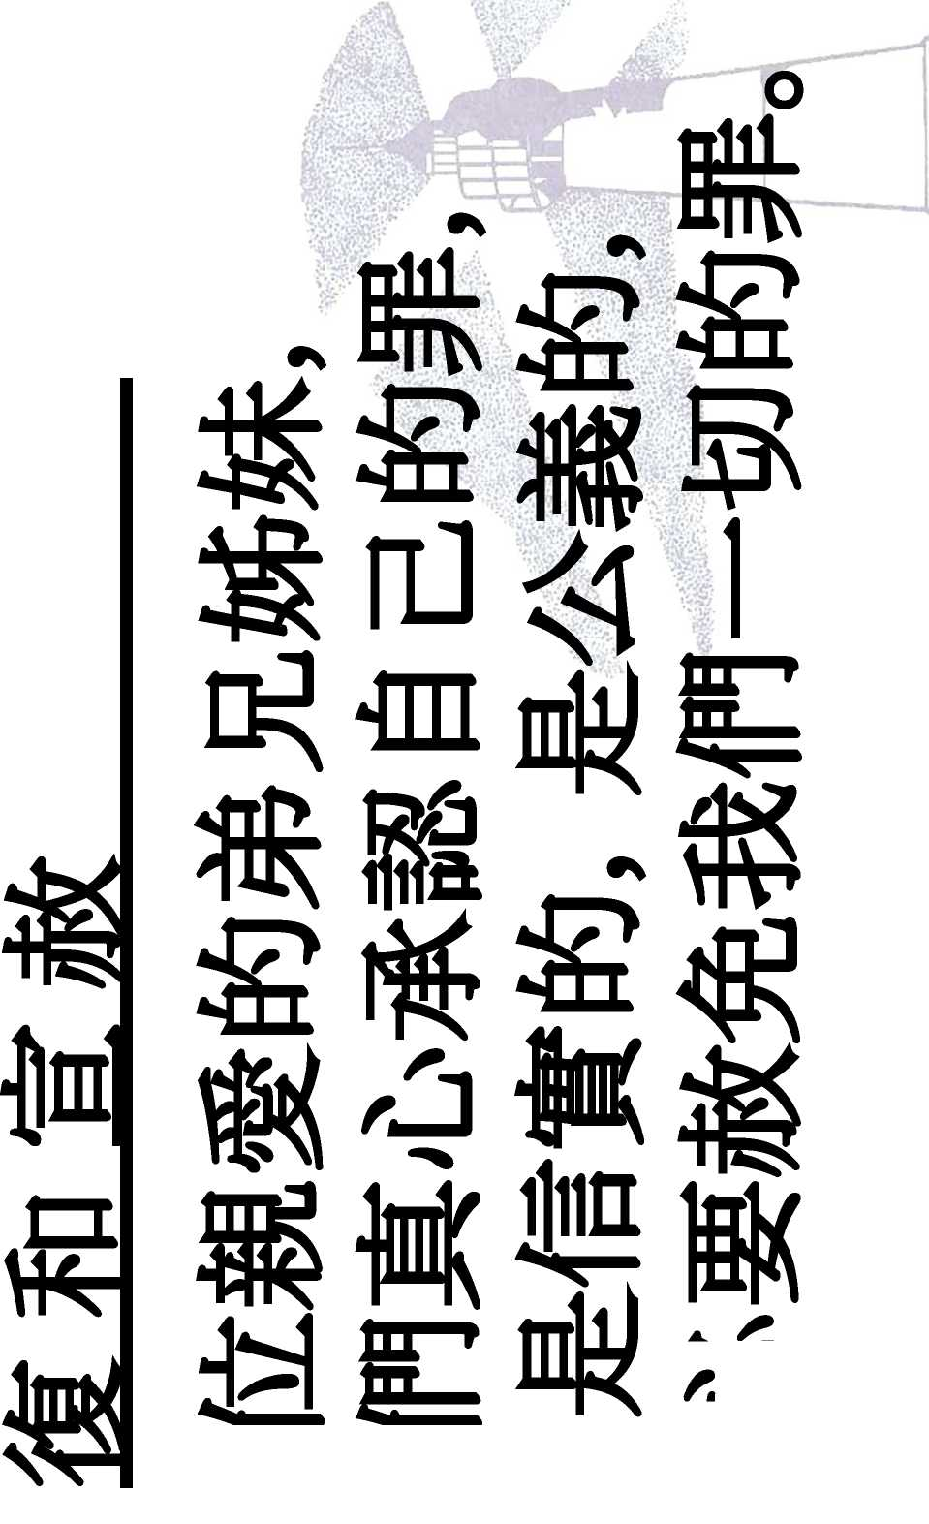
Absolve

Slide 12
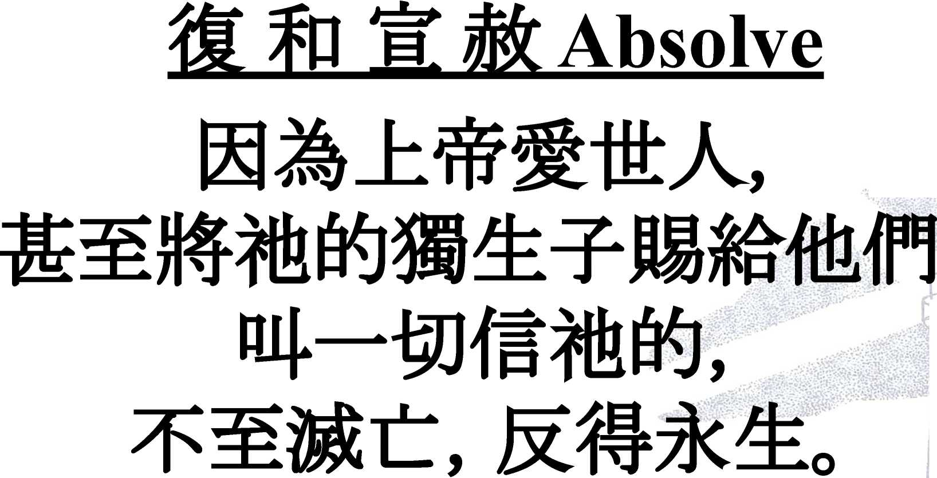

Slide 14
Praise

Slide 15
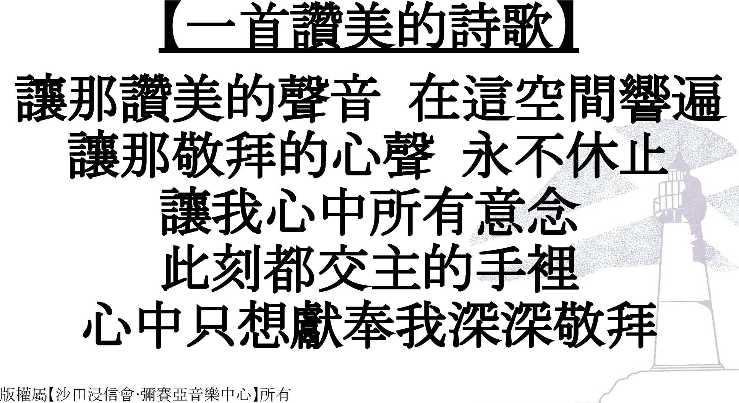

Slide 17
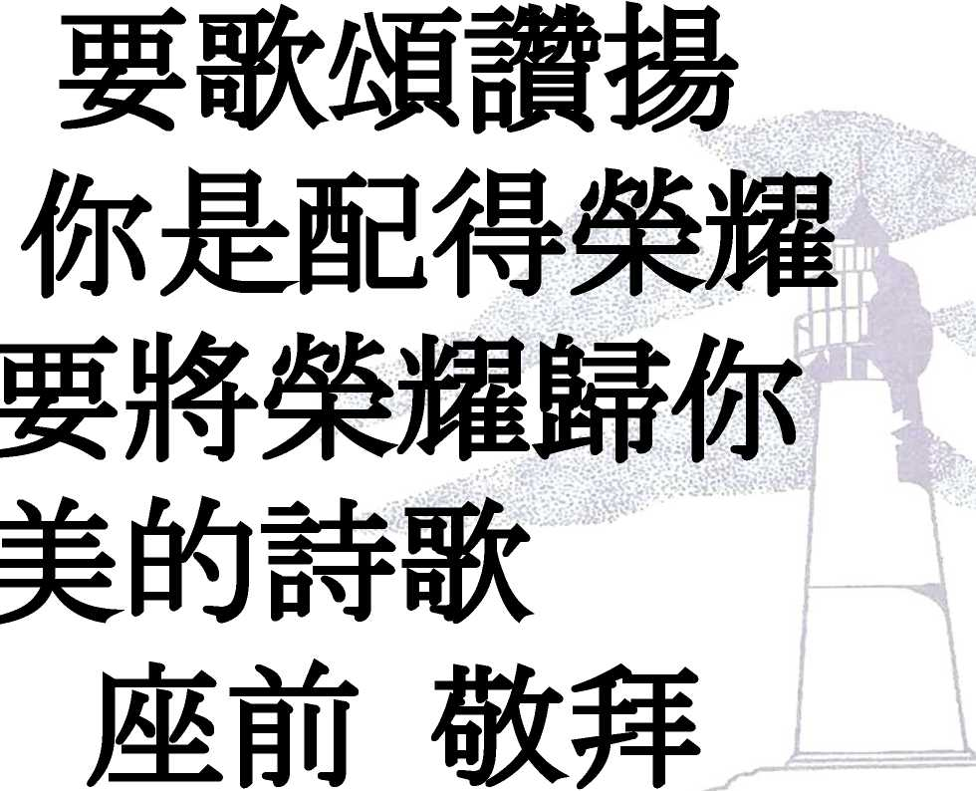

Slide 19


Slide 21




Slide 22
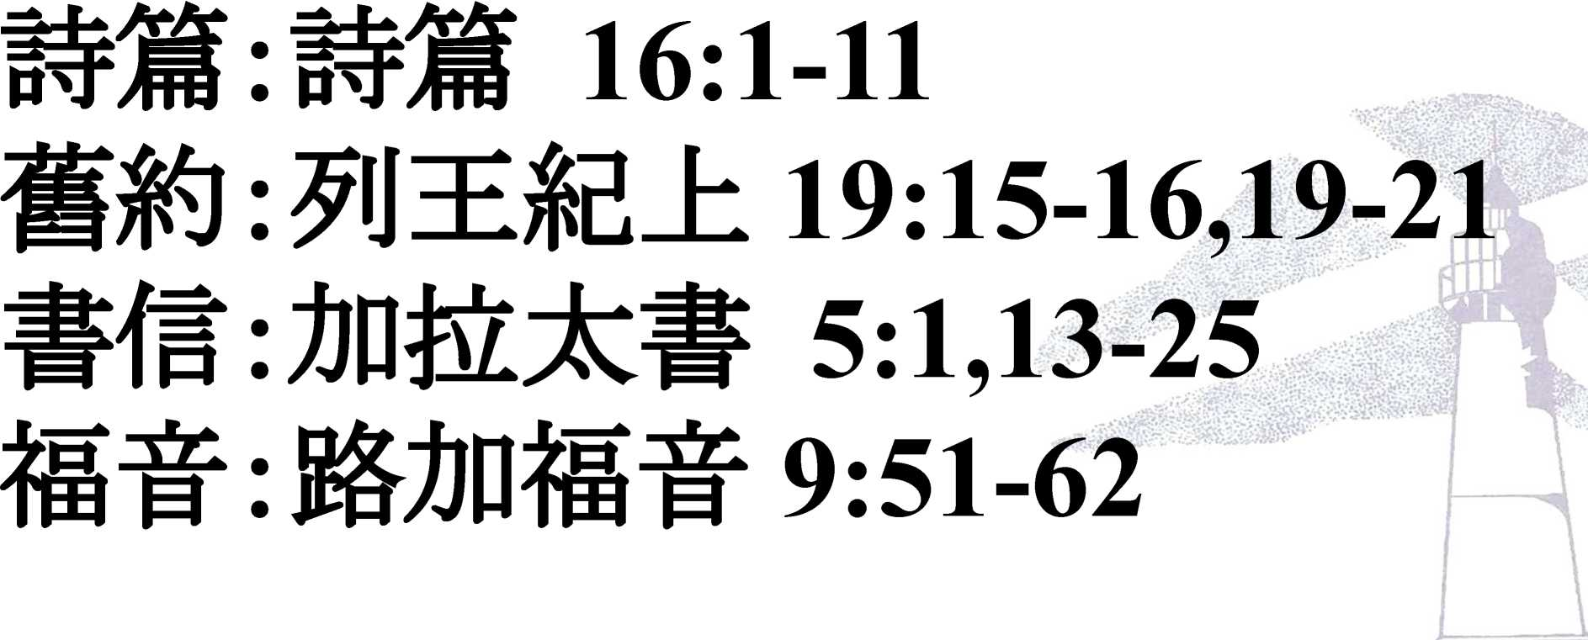
£ Wk The Word

Slide 23
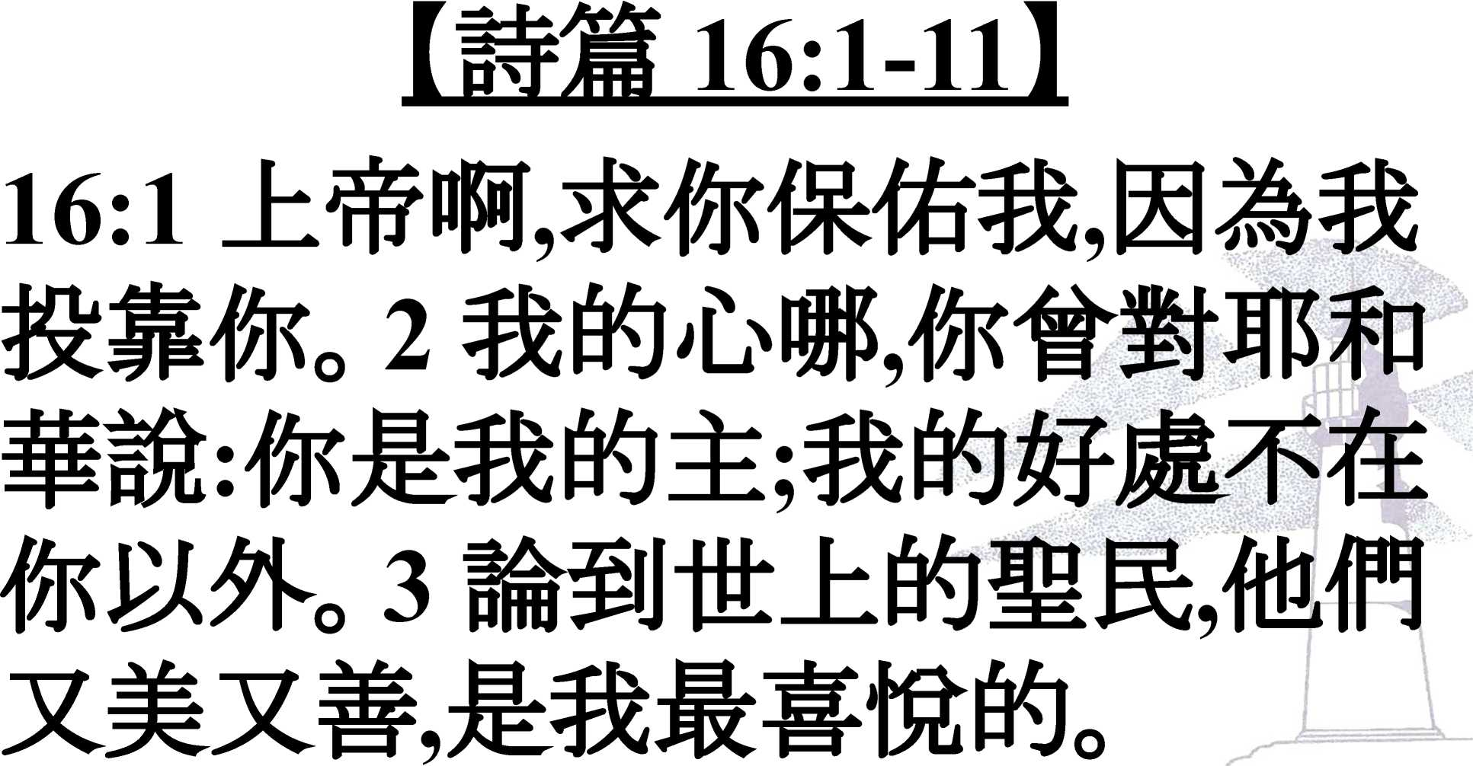

Slide 24
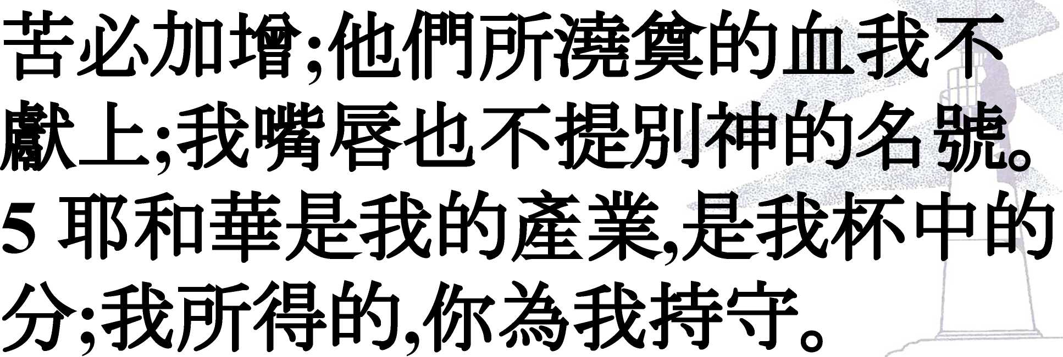

Slide 25
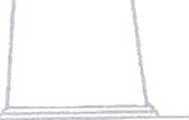

Slide 26
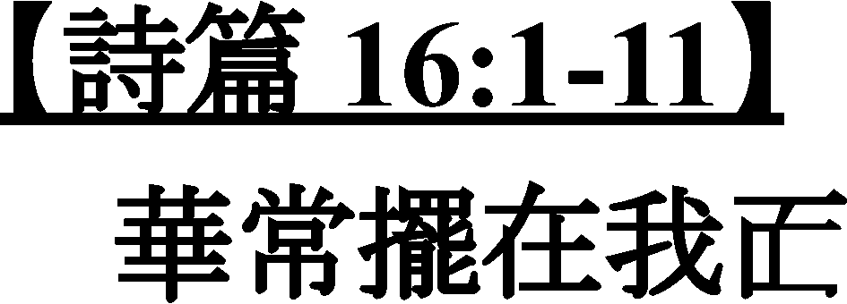
Ill

Slide 27
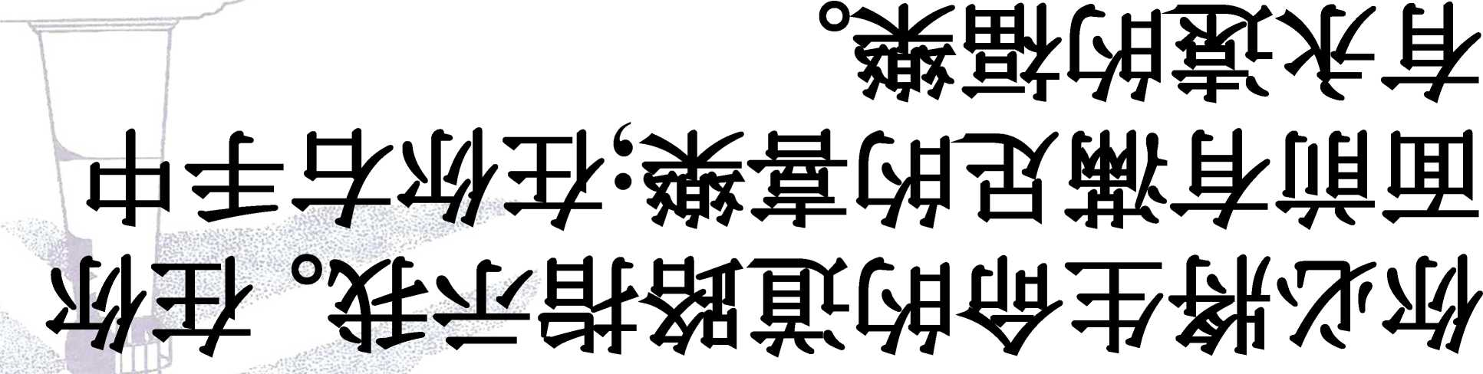

Slide 28
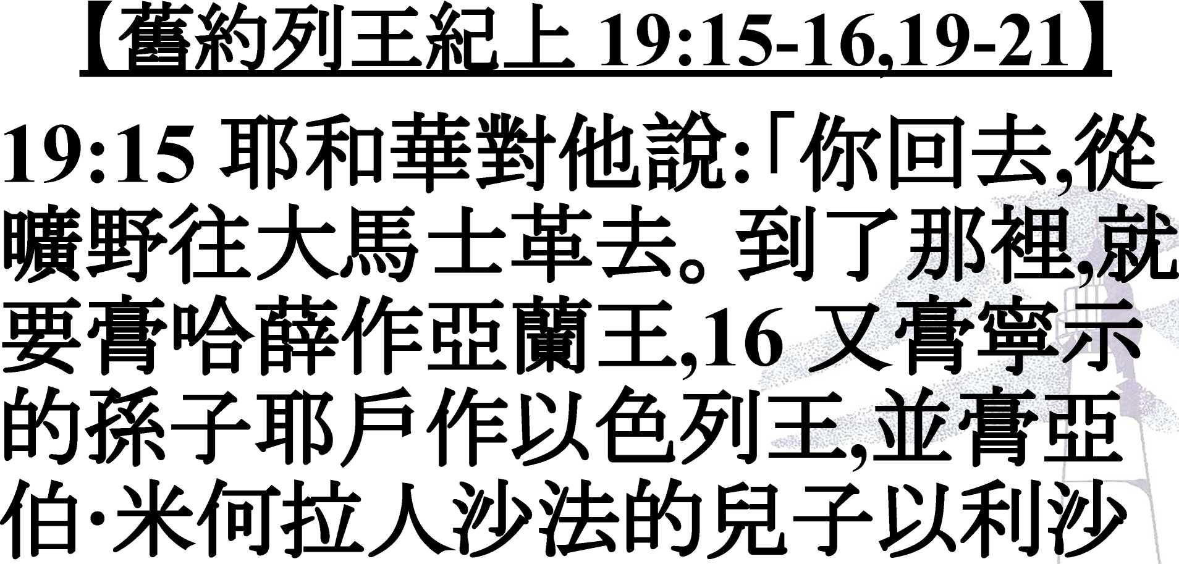

Slide 29
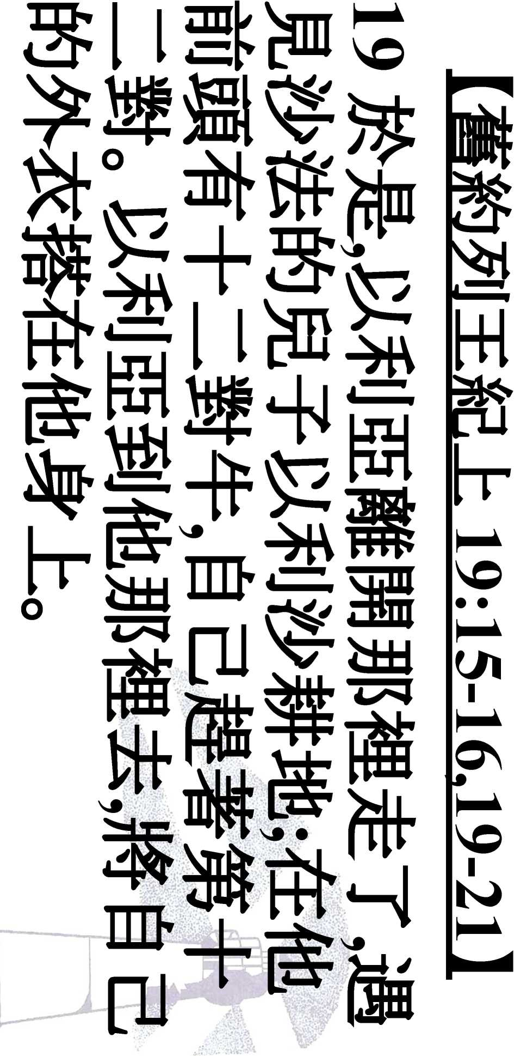

Slide 30
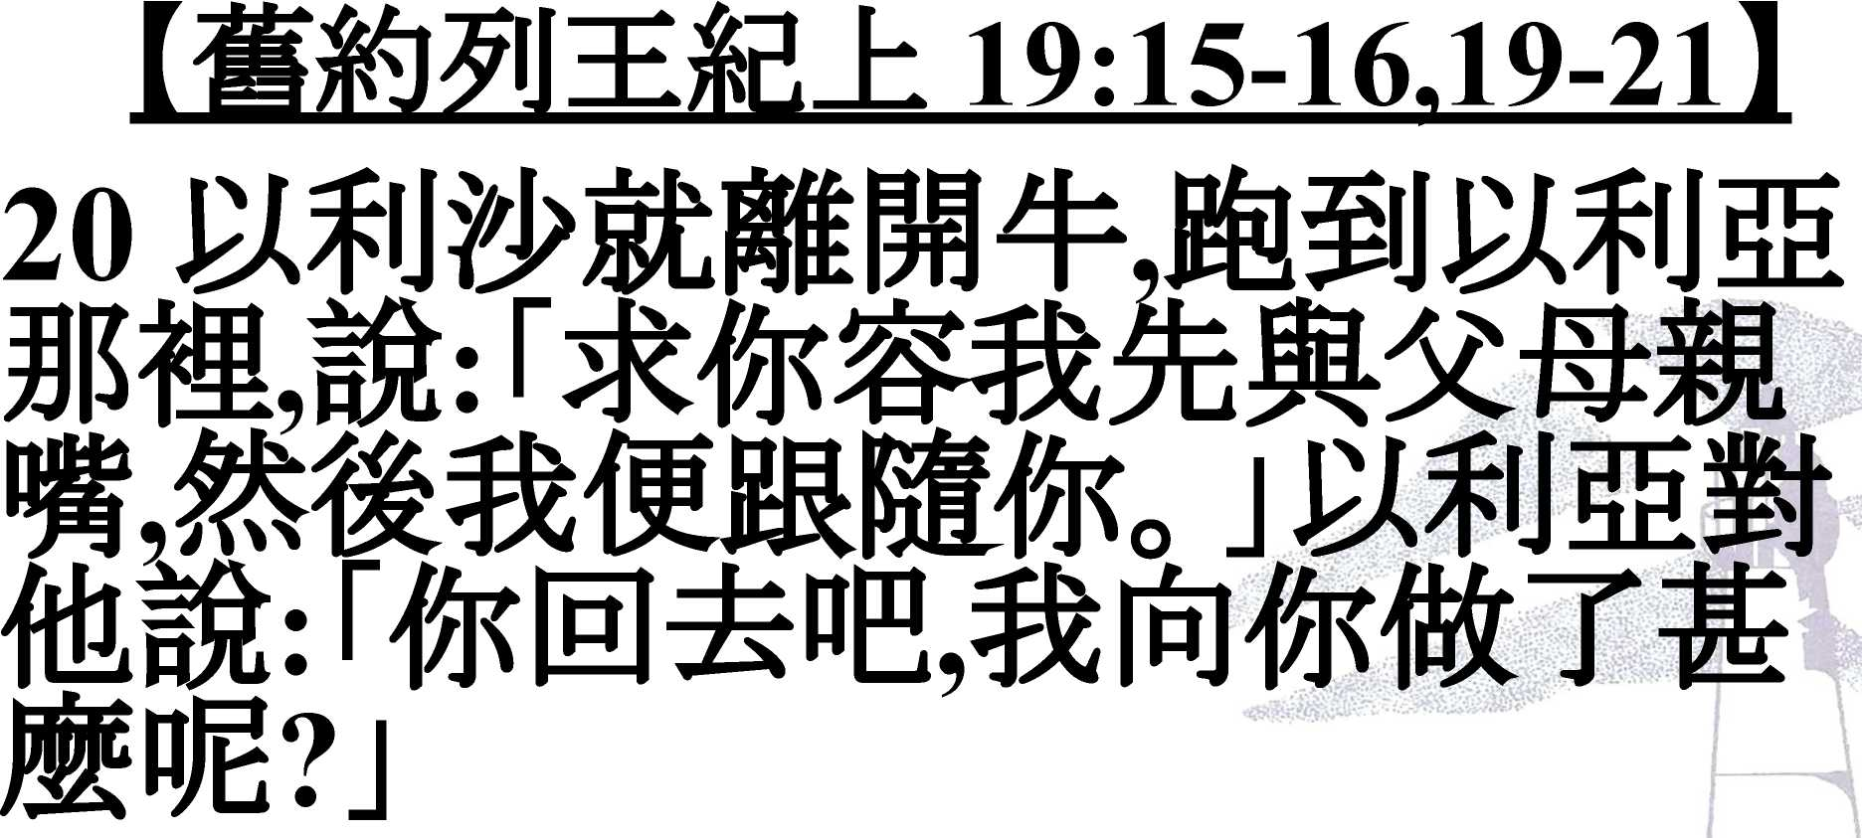

Slide 31
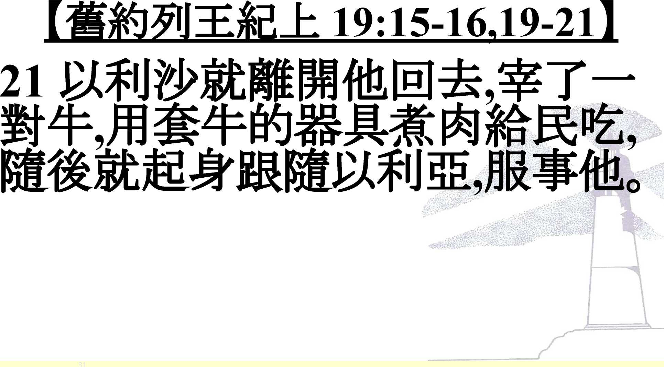

Slide 32
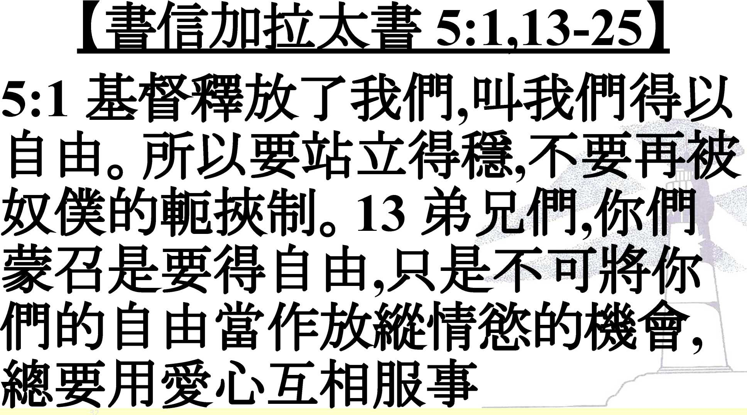

Slide 33
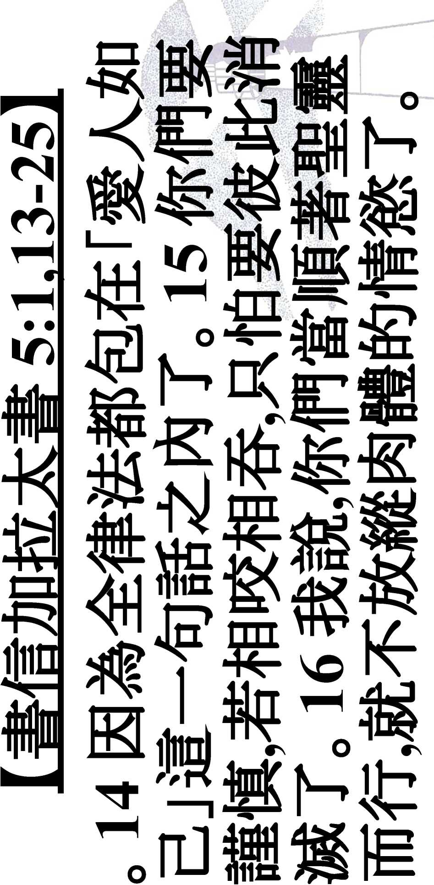

Slide 34
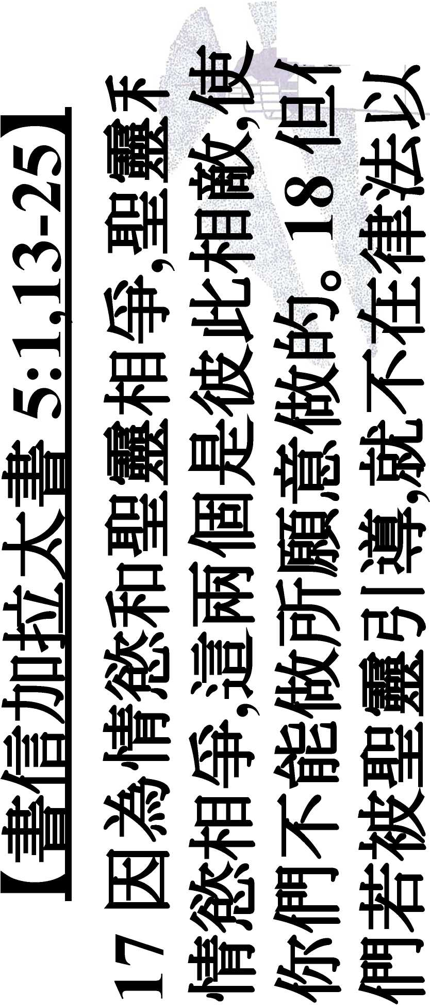

Slide 35
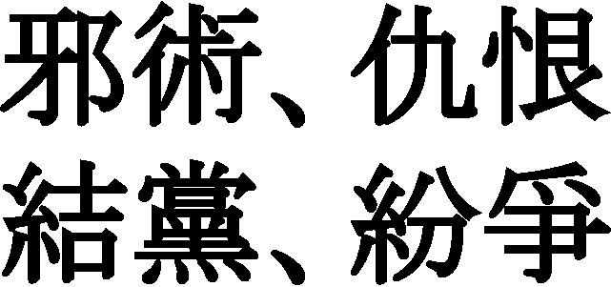
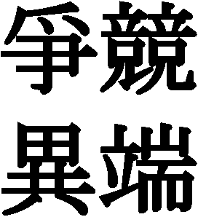

\
ism,
\
>

Slide 36
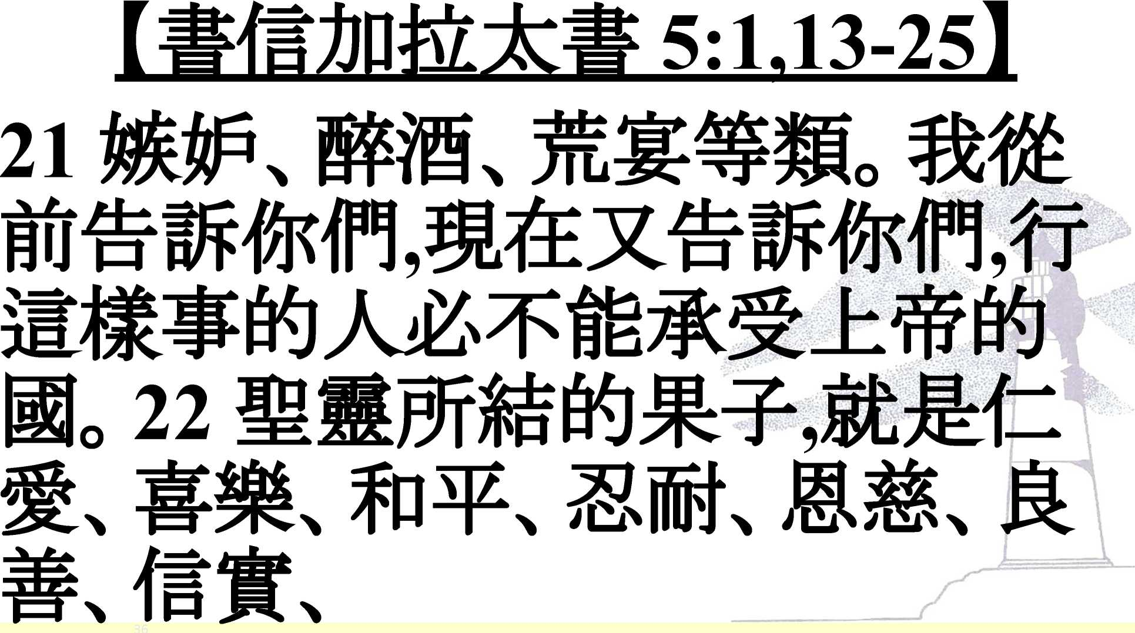

Slide 37
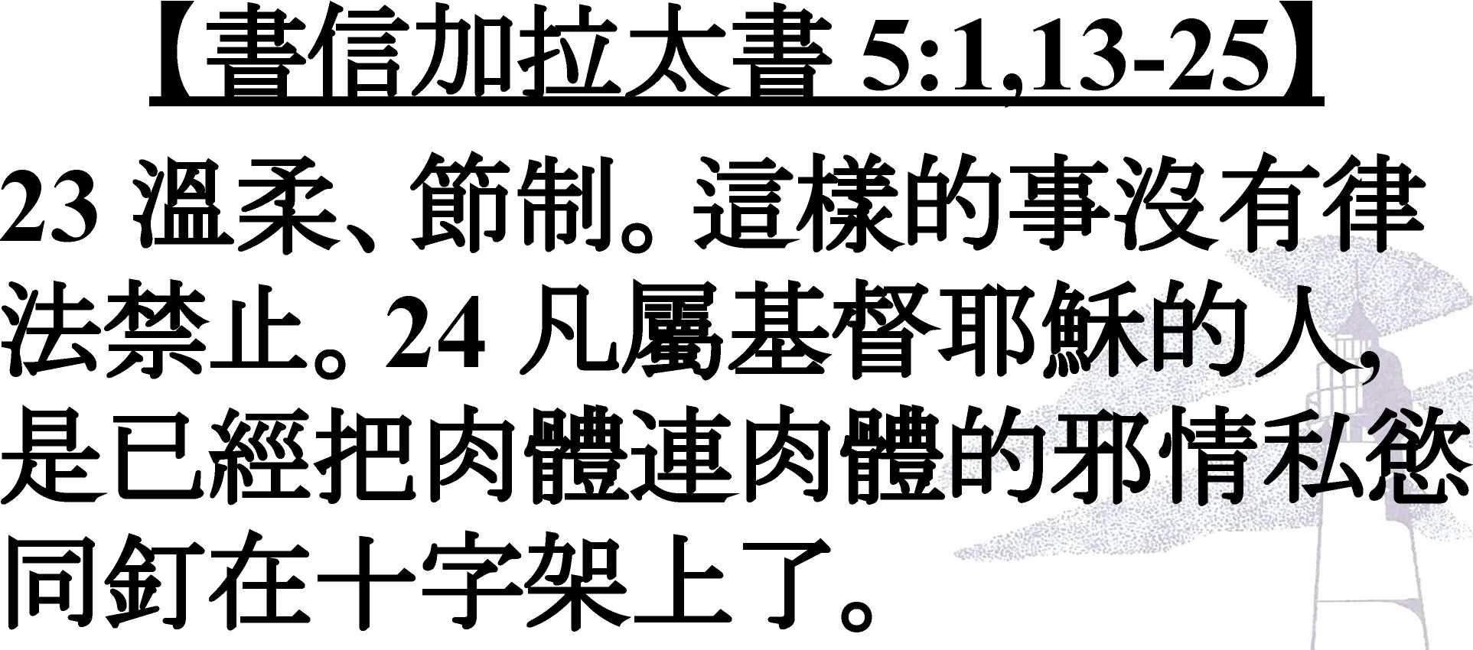

Slide 38
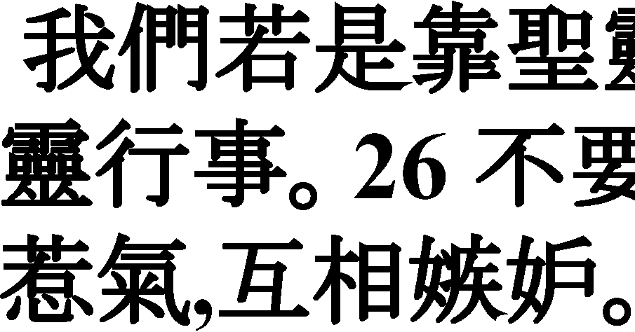
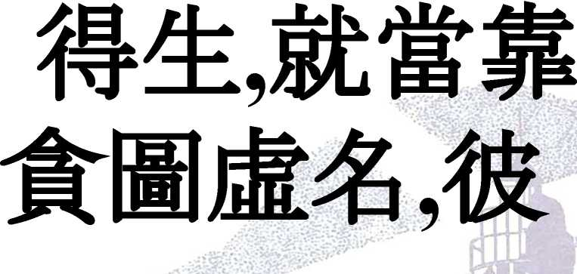

Slide 39
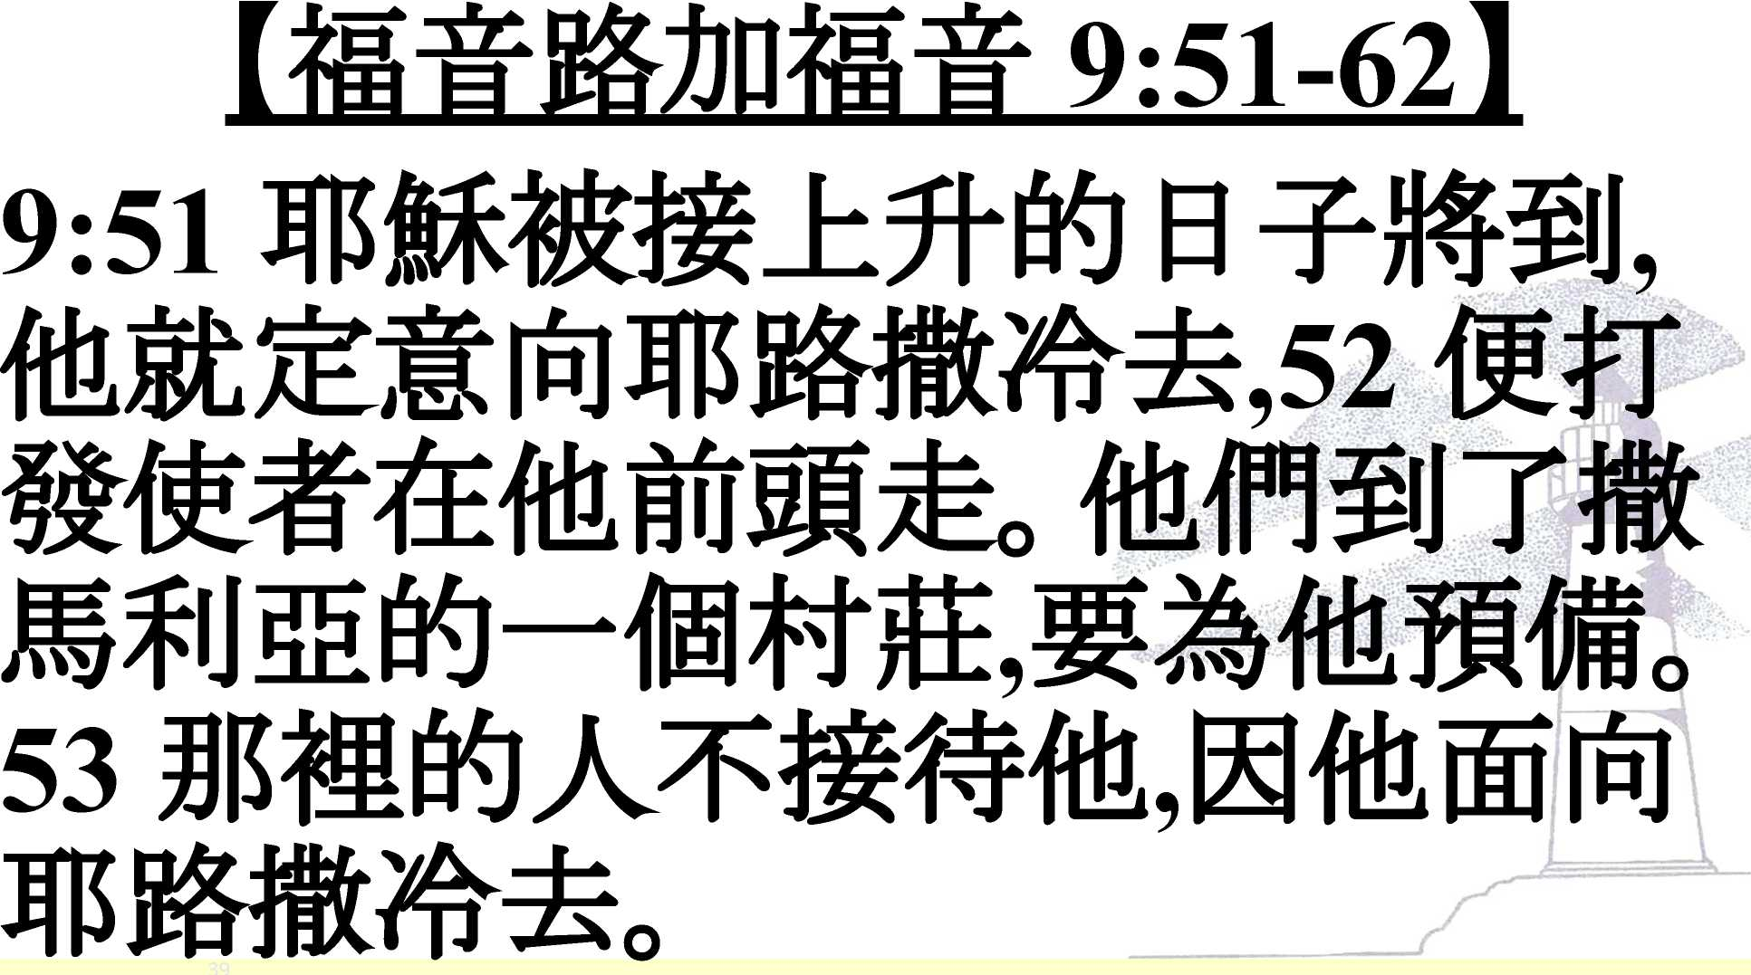

Slide 40
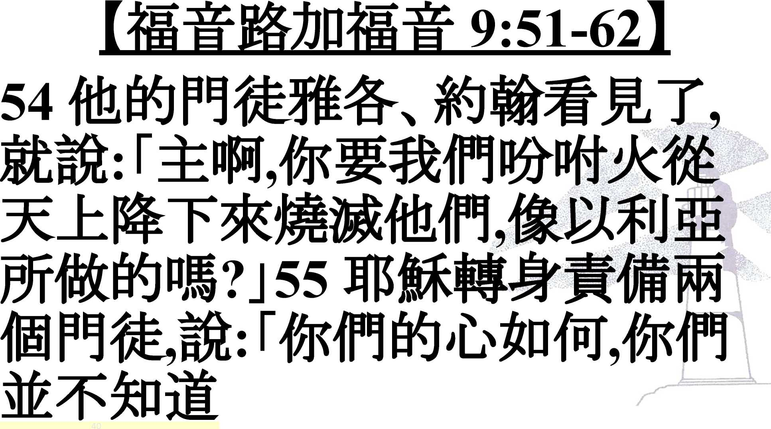
o

Slide 41
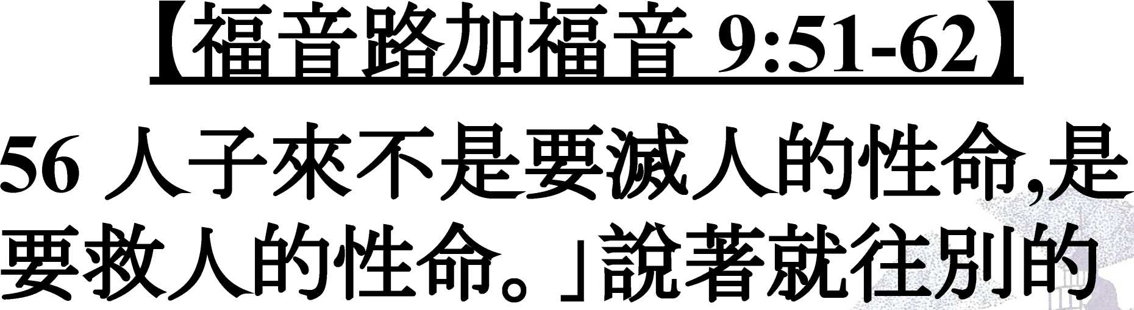

Slide 42
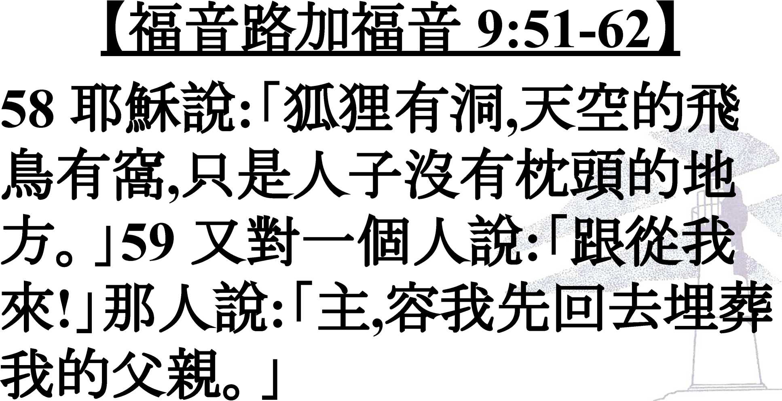

Slide 43
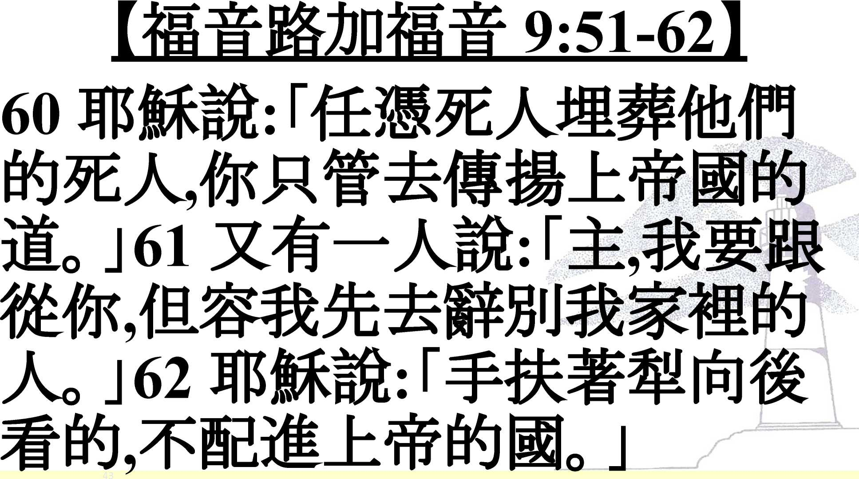

Slide 44

Song of The Day

Slide 45
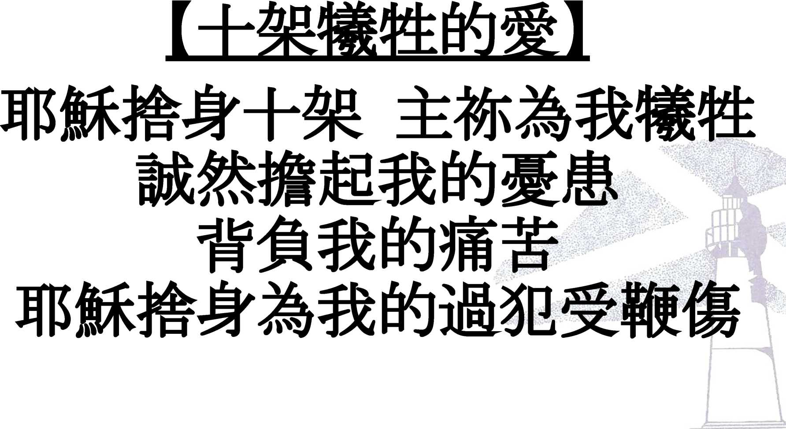

Slide 46
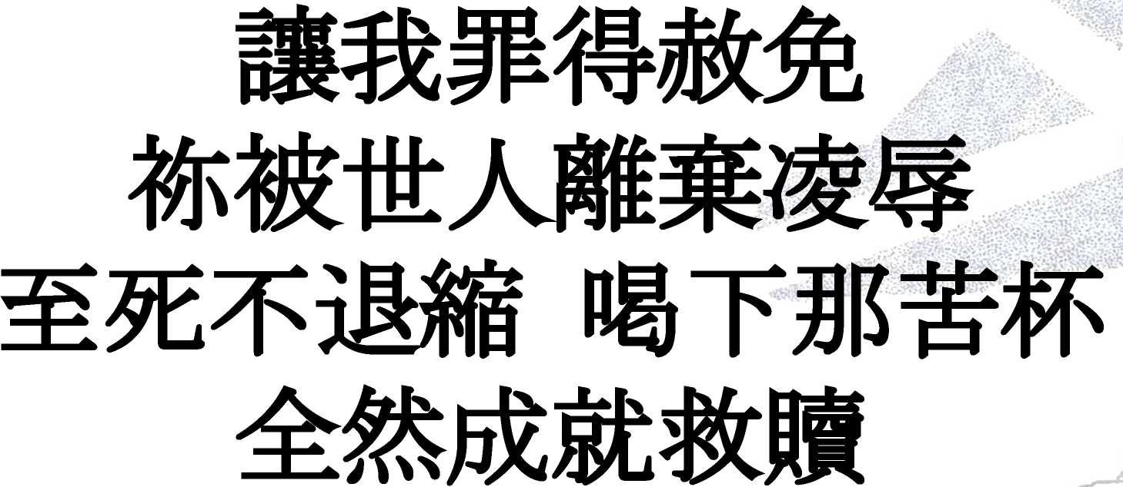

Slide 47
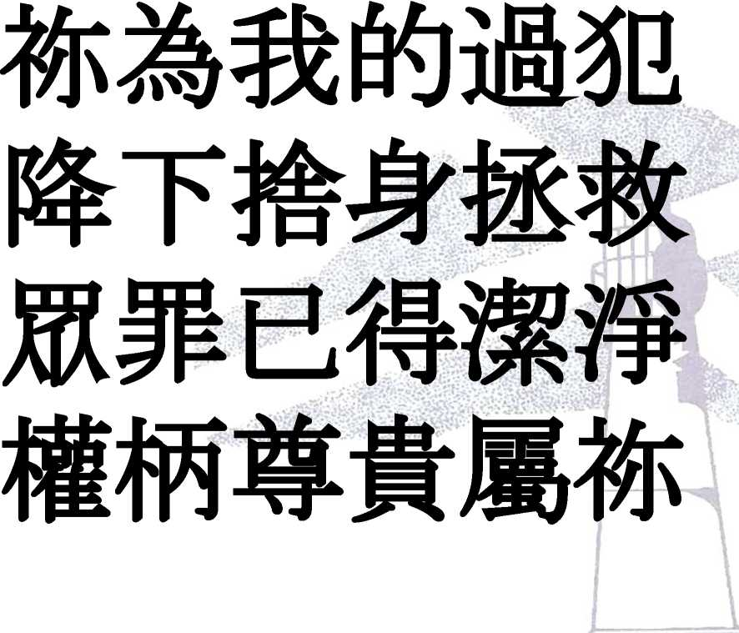

Slide 52
Sermon
W 9:51-62

Slide 53


Slide 54

o

Slide 57


Slide 58
Sermon
W 9:51-62

Slide 59


Creed

Slide 60
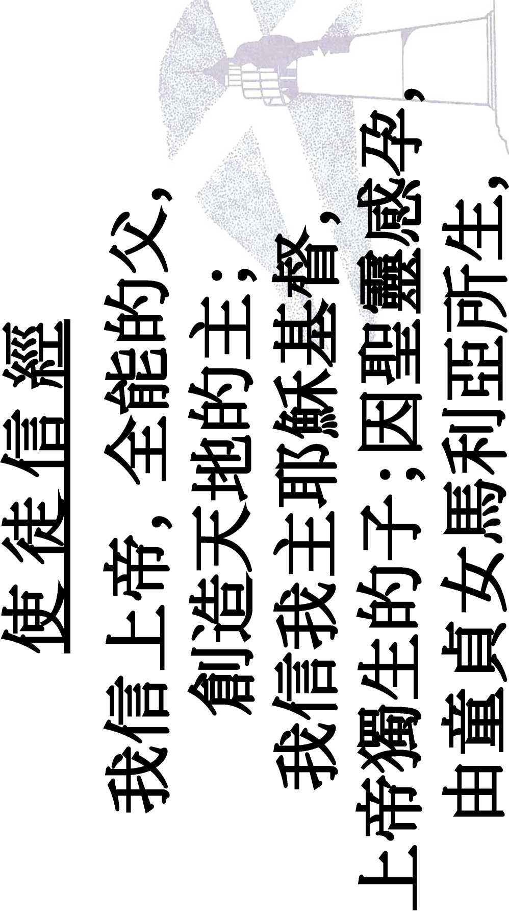

Slide 61
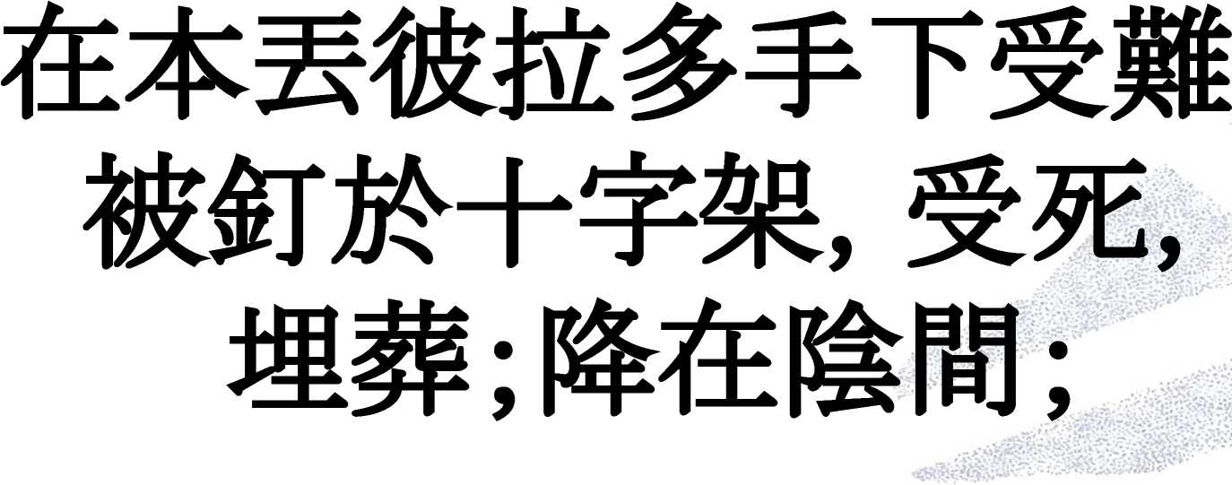

Slide 62
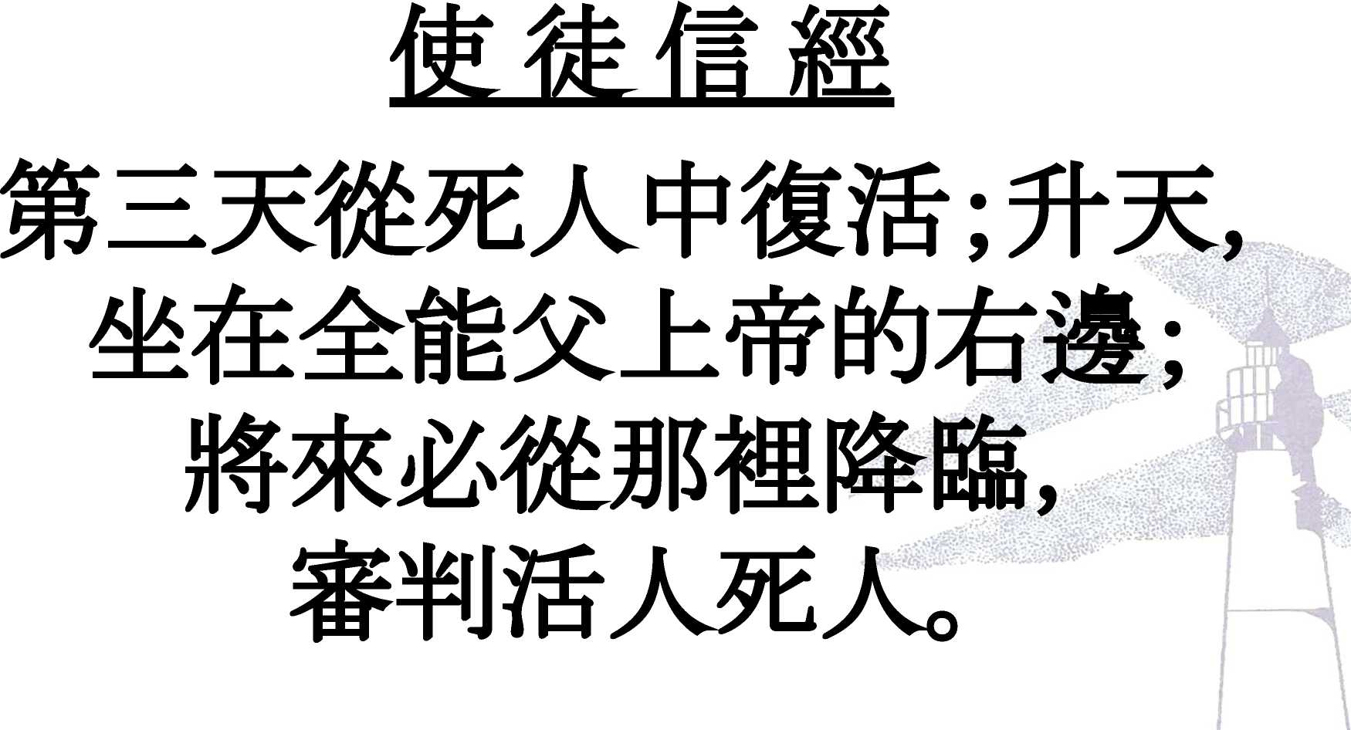

Slide 63
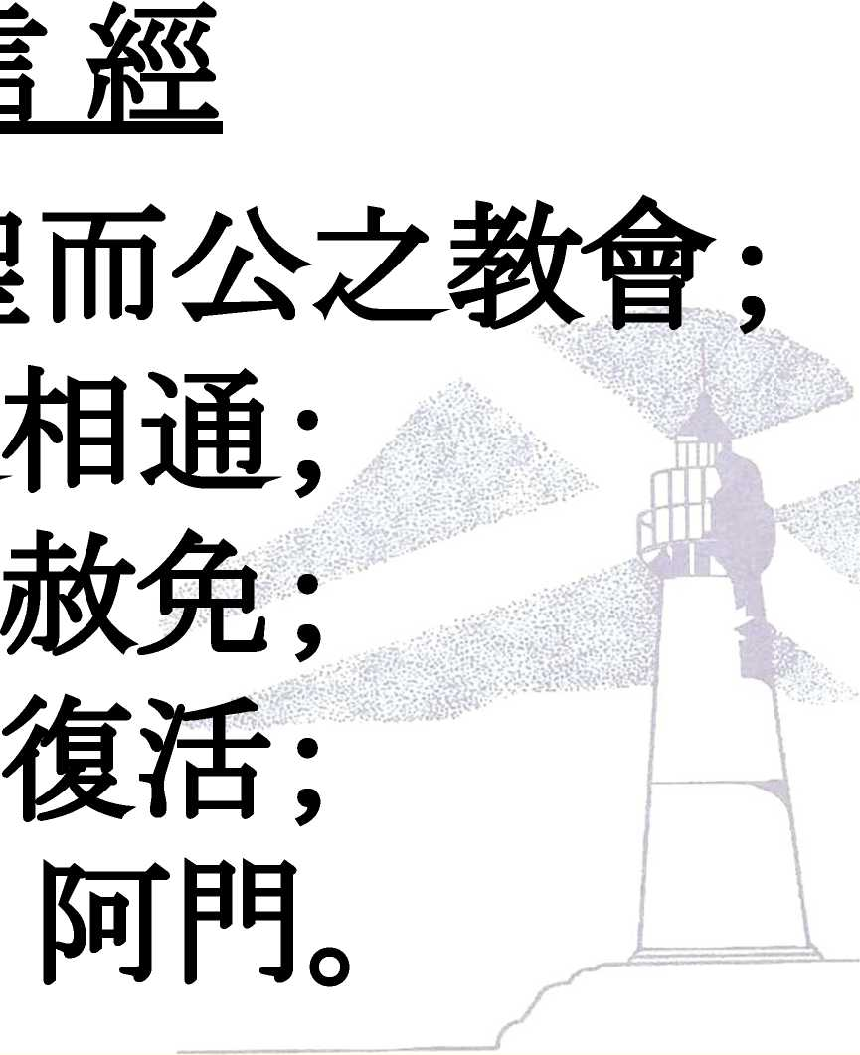


Slide 64
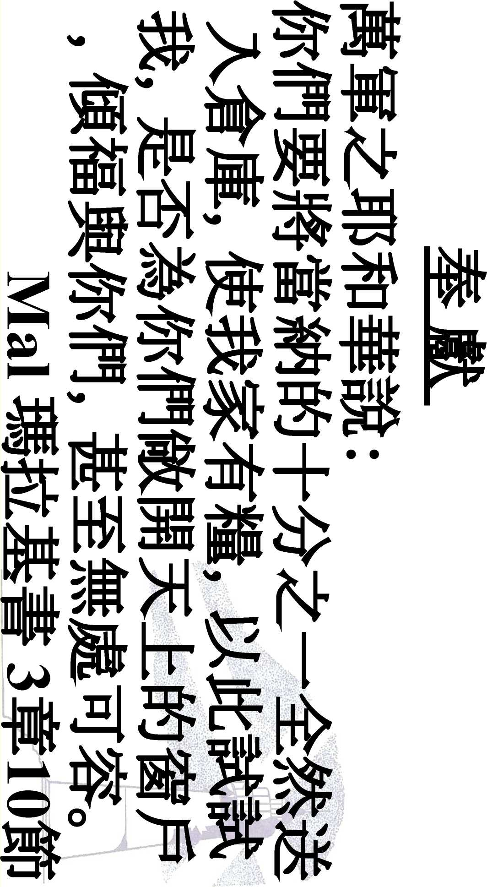
Offering

Slide 65
||fc Offering
mfAWum±.mmp o:
: SALEM-SAM SHING LUTHERAN CHURCH
Mf: * (012)
: 012-710-00035109
whatsA_{PP}pj“m^”fm^,
#$UdS&lkm **it#^IHRA+—*it

Slide 66
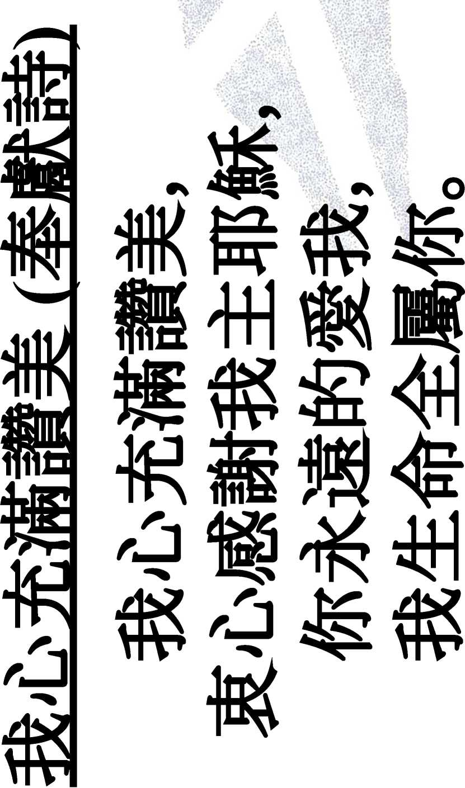

Slide 67
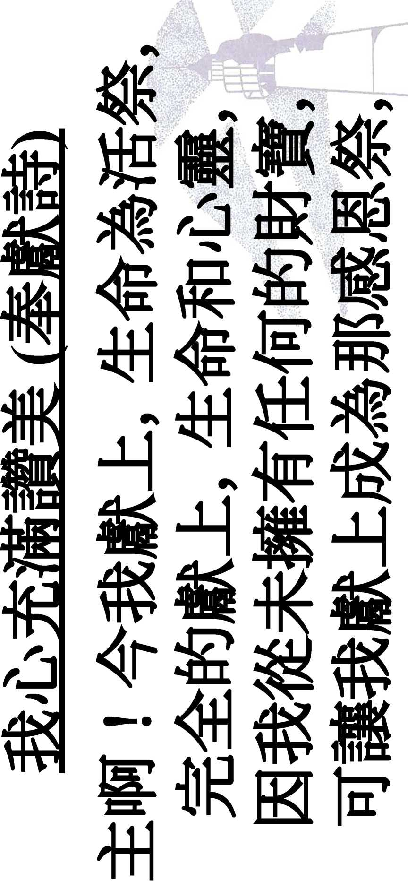

Slide 68
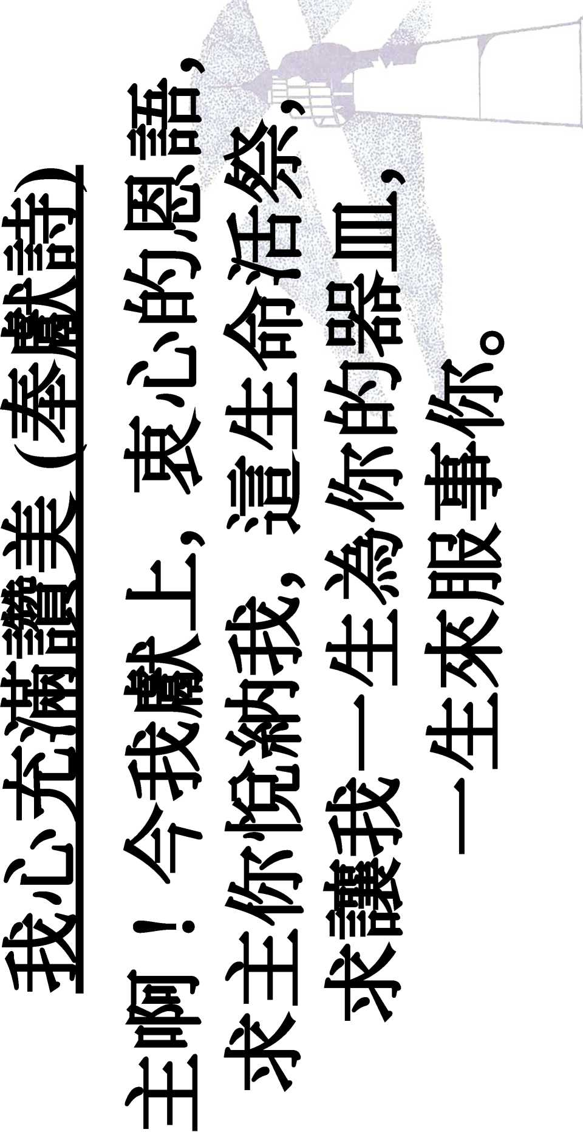

Slide 69
Prayer

Slide 70
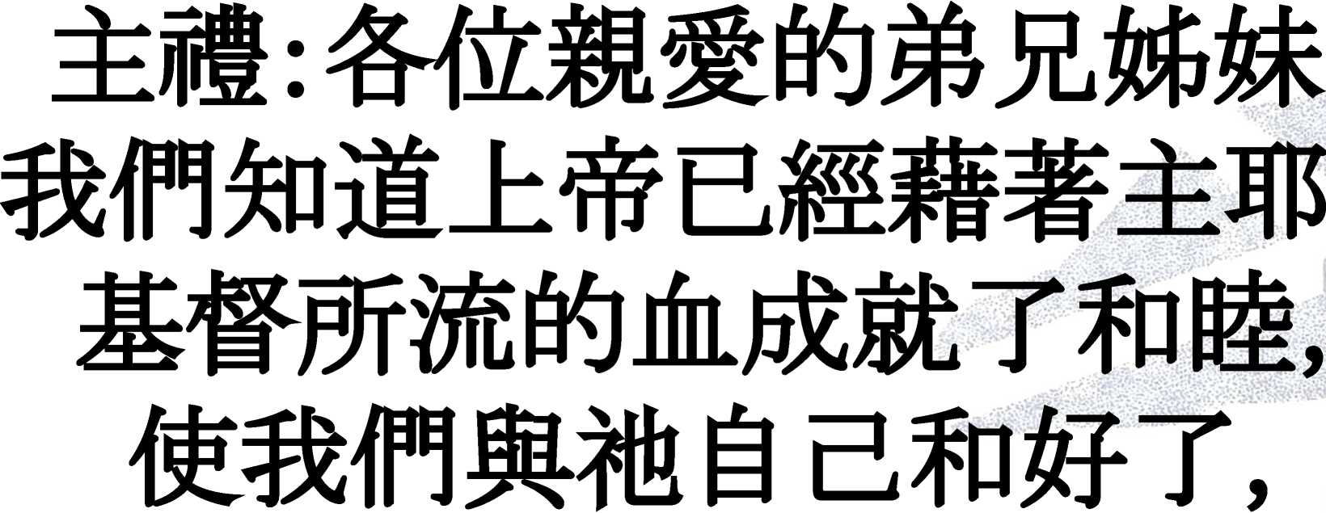

Slide 71
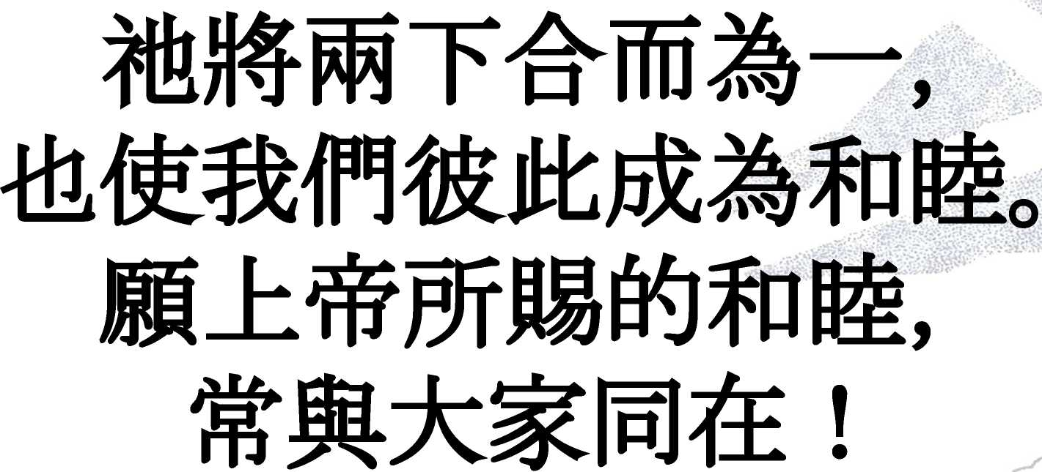

Slide 72



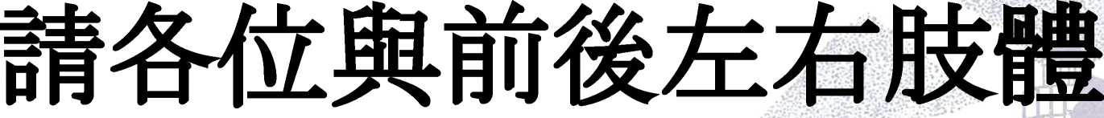
econcmation
jr :-timnwwRtt
n rj

Slide 73



Slide 74

Report

Slide 75






2022^7J! 3
iiiii:
p-
#*S:
1
if

Slide 76


Slide 77

(SUM [Music 2000 IfJpPT

Slide 78



Slide 79

(SUM [Music 2000 IfJpPT

Slide 80


(SUM [Music 2000 IfJpPT

Slide 81
(SUM [Music 2000 IfJpPT

Slide 82
(SUM [Music 2000 IfJpPT

Slide 83
(SUM [Music 2000 IfJpPT

Slide 84
(SUM [Music 2000 IfJpPT

Slide 85
(SUM [Music 2000 IfJpPT

Slide 86
Benediction

Slide 87


